Slide 1
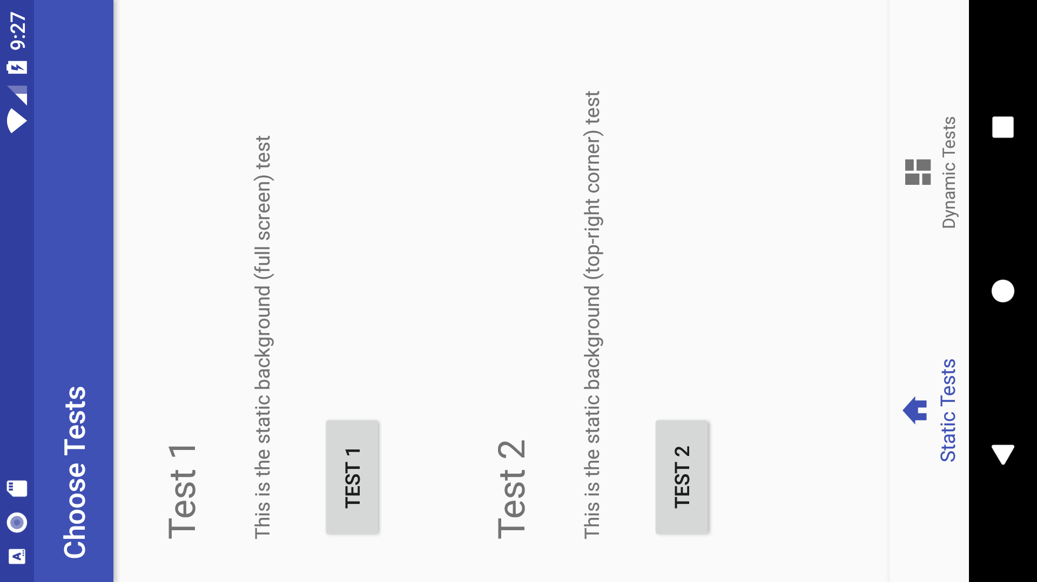


Slide 3


Slide 4


Slide 5


Slide 6


Slide 10
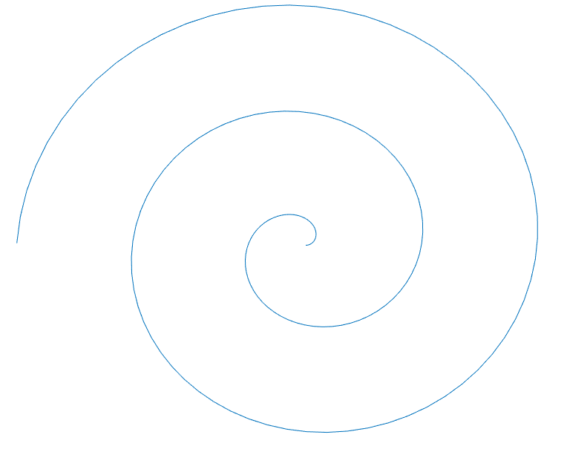

Slide 12


Slide 13
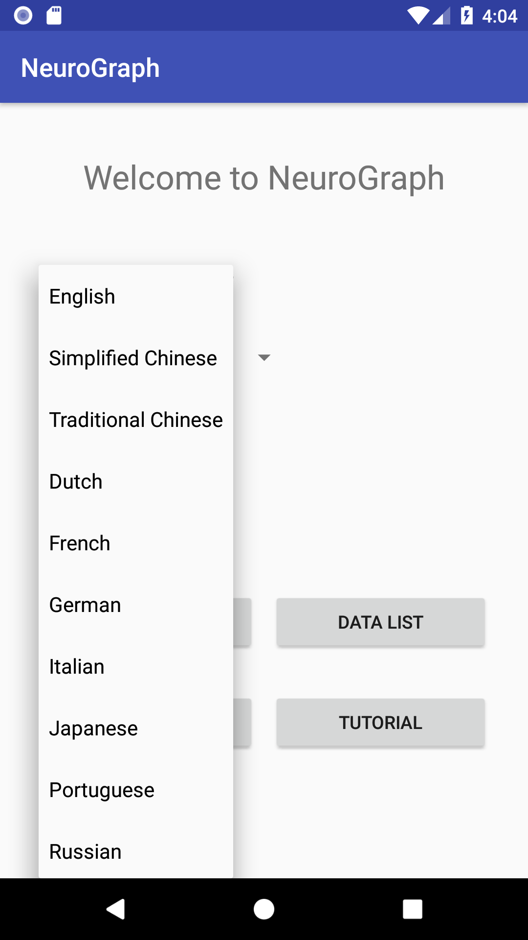

Slide 14


Slide 20



Slide 21



public void init_theme () { switch (colour) { case "Blue": setTheme(R.style.AppThemeBlue);break;

Slide 25
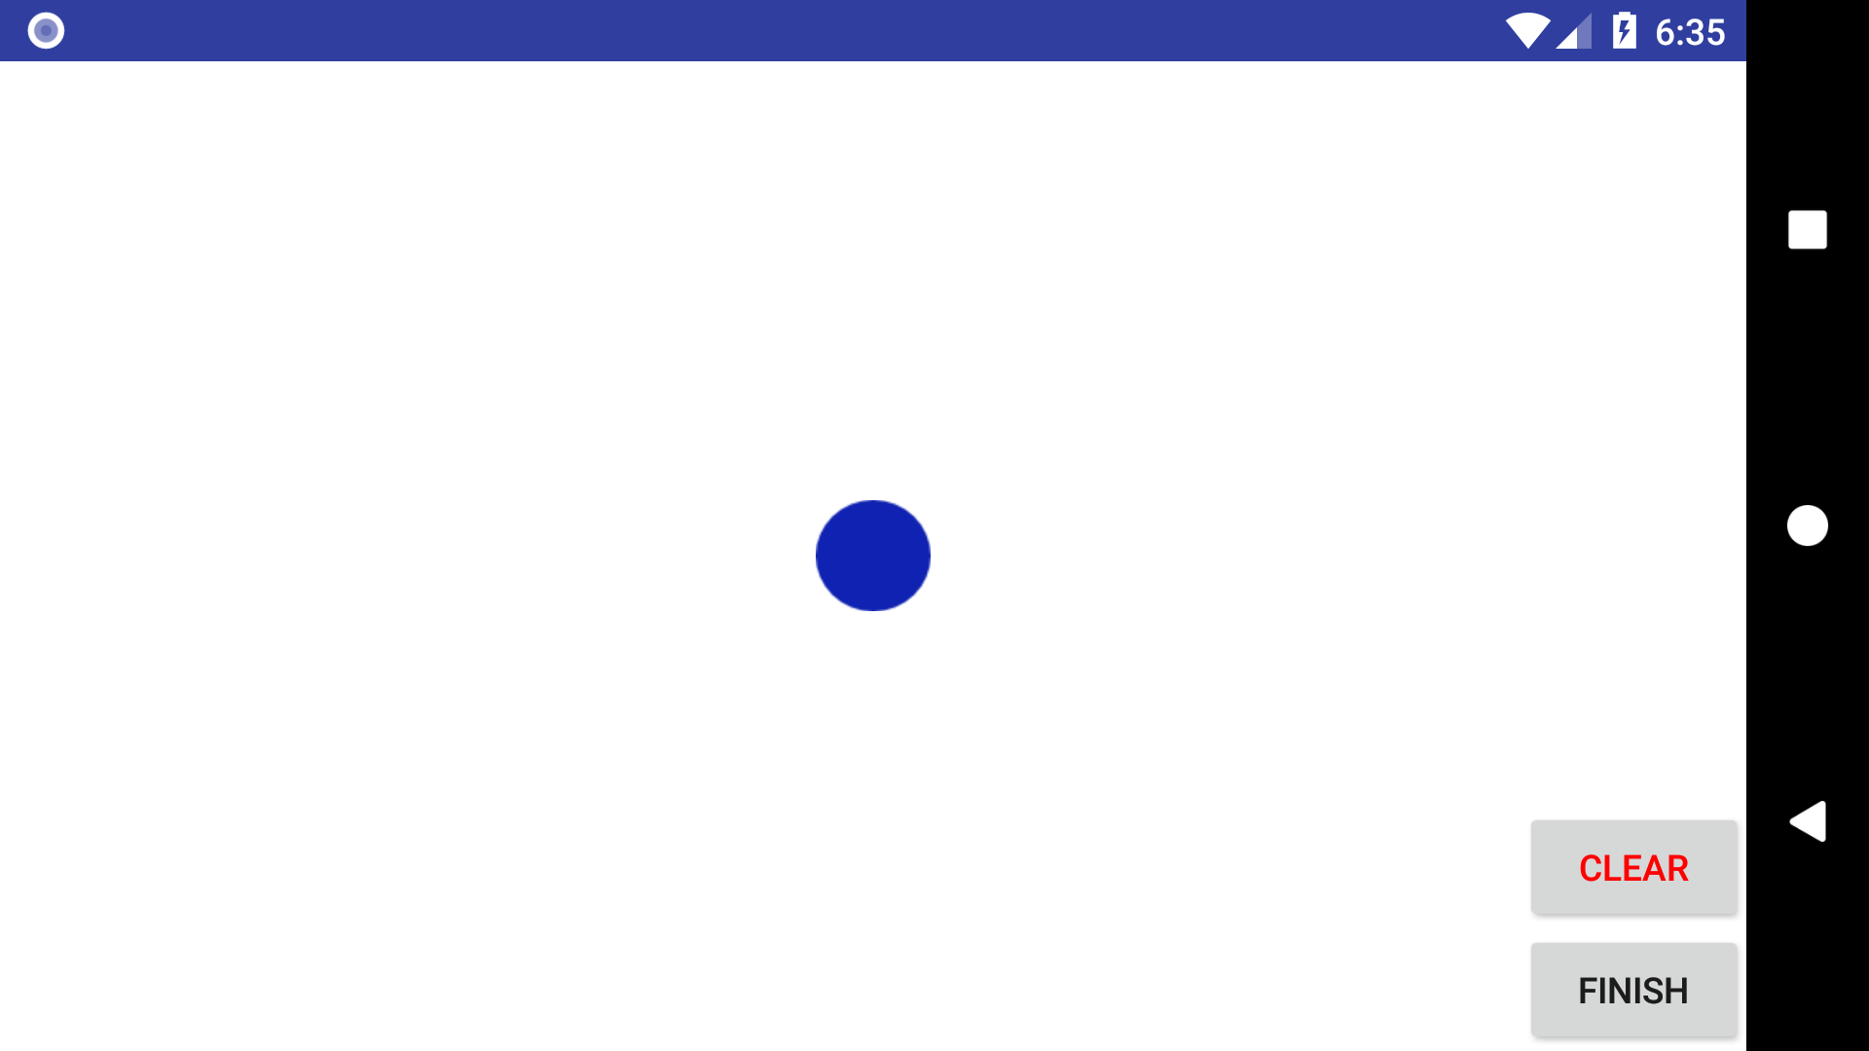

Slide 26
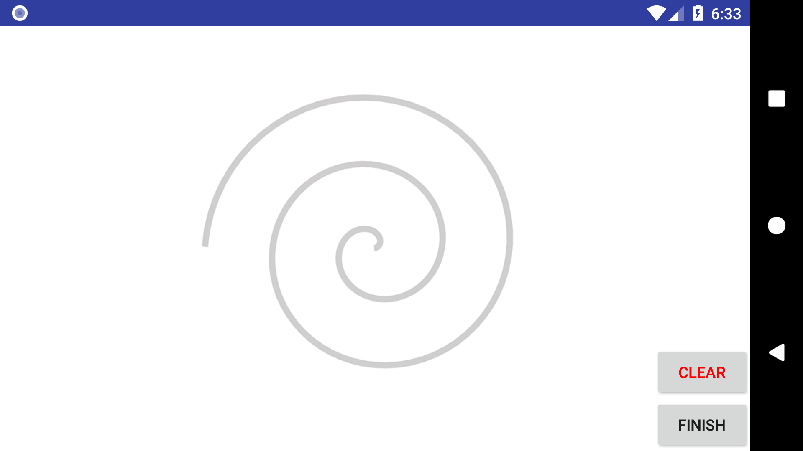

Slide 27
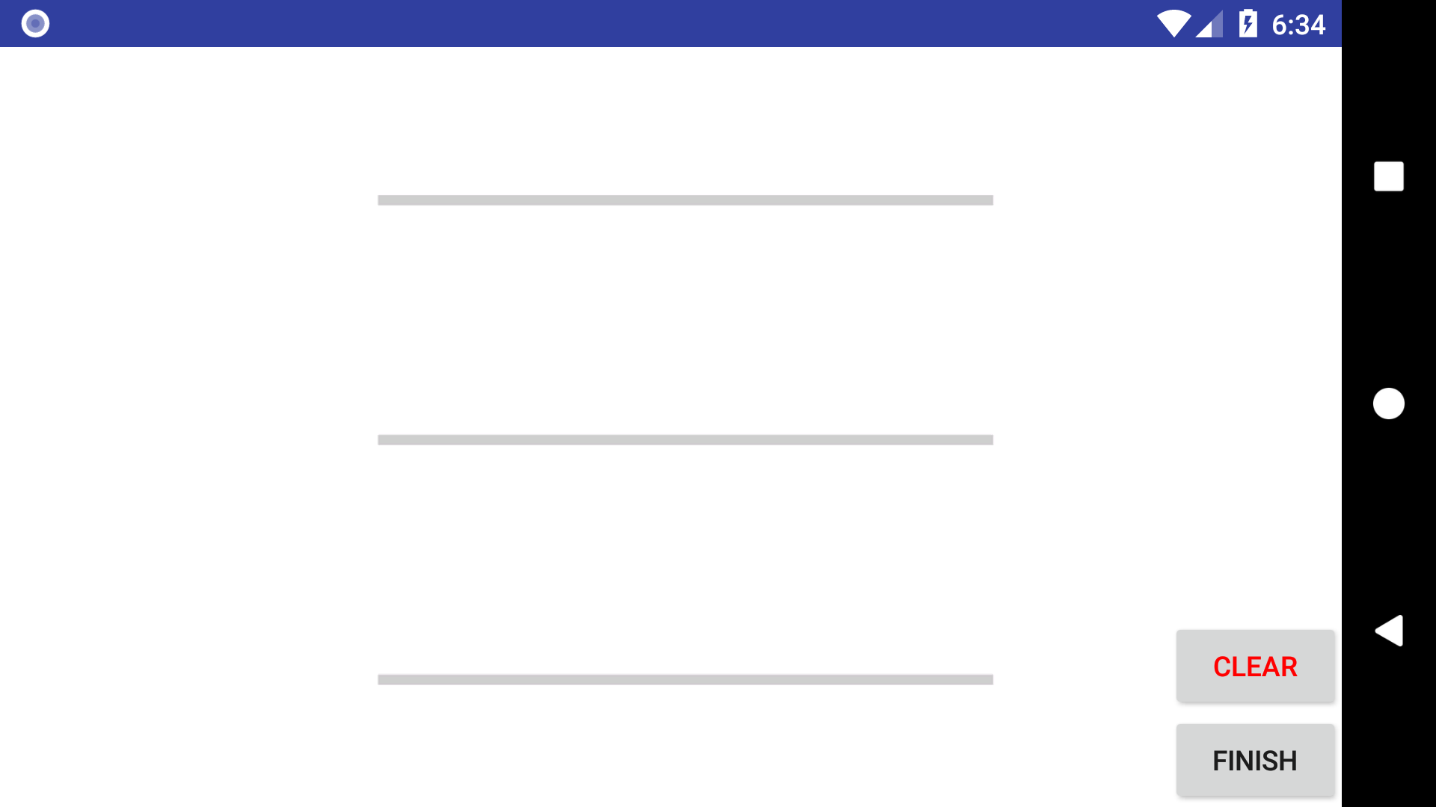

Slide 28
